Slide 1
Introduction to Machine Learning

Slide 2
Contents
Introduction to Machine Learning
Applications of Machine Learning
Branches of Machine Learning
Supervised Learning
Unsupervised Learning
What is Supervised Learning?
Supervised Learning Tasks – Regression and Classification
Types of Regression
Learning a Linear Regression Model
Validating a Regression Model

Slide 3
Introduction to Machine Learning

Slide 4
Intro to Machine Learning
Motivation: Traditional programming involves writing explicit set of instructions to enable computer/machine to perform a task
Question: Why do computers or machines need to learn something?
Answer: Not all tasks can be programmed for a computer to perform
Eg 1: Recognising objects or persons in an image
Eg 2: Understanding human language or speech
Eg 3: Driving a vehicle following traffic rules
Eg 4: Predicting output when input-output relation is not known
Therefore, machine learning is required in following cases:
Humans cannot explain how to perform a task
Humans do not have the expertise to perform a task

Slide 5
Machine Learning: Definition and Branches
A sub-field of AI in which computer programs learn a task from data without being explicitly told how to perform that task
Learning of the task happens in multiple stages through experiences gained from data
Borrows some ideas from how humans learn different tasks
It may be better or worse than humans in performing tasks
Branches of Machine Learning
Supervised
learning
Unsupervised
learning
Reinforcement
learning
Deep Learning

Slide 6
Application of Machine Learning
Machine Learning has wide range of applications in many fields and its application keep growing day by day
Following are some of the areas in which machine learning is being widely employed:
Predictive tasks in different fields
Training autonomous agents such as cars, robots, etc.
Computer vision tasks
Natural language processing tasks
Healthcare
Engineering – Analysis, Optimization, Predictions, Control

Slide 7
Branches of Machine Learning

Slide 8
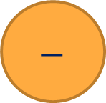
Supervised Learning
Learning to perform a task in the presence of a supervisor
Generally, the task is to predict the output given an input
Involves learning an input-output relation
Data is set of samples with inputs mapped to outputs (targets)
Supervised learning tasks: Regression and Classification
Supervised Learning Task
Relation
Input
Output
$$−$$
Feedback
Target
(Supervisor)

Slide 9
Unsupervised Learning and Reinforcement Learning
Unsupervised Learning:
Learning patterns in data with no labels i.e., there is no target (no supervisor)
No notion of input or output and hence does not involve prediction
Clustering and outlier detection are unsupervised learning tasks
Reinforcement Learning:
Agents learn to take a series of decisions/actions optimally in a given environment
Learning happens through rewards received from the environment
Similar to how humans perfect tasks through experience

Slide 10
Some Terminology
Input variables
Output/Target variables
Features
Data
Model
Parameters of the model
Training/Learning
Hyperparameters

Slide 11

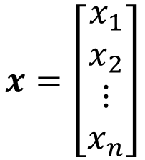



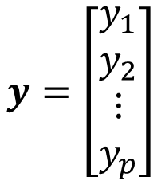
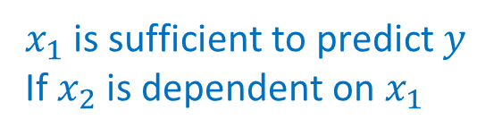
Input and Output Variables
Input variables represent the input of the task on which the output of the task depends
Output variables represent the output of the task which is to be predicted
In ML tasks, they are generally represented in vector form
Generally, inputs should be independent variables while outputs should be dependent on the inputs
$$x=\left[\begin{matrix}x_{1} \\ x_{2} \\ ⋮ \\ x_{n}\end{matrix}\right]$$
$$y=\left[\begin{matrix}y_{1} \\ y_{2} \\ ⋮ \\ y_{p}\end{matrix}\right]$$
$$x→y$$
$$y=x_{1}+x_{2}$$
$$x_{2}=2x_{1}$$
$x_{1}$ is sufficient to predict $y$
If $x_{2}$ is dependent on $x_{1}$
$$y=3x_{1}$$

Slide 12
Types of Variables
Numerical Variables: Variables which can be measured and placed in ascending or descending order
Continuous variables: Numerical variables which can take continuous values
Eg. Person’s height, weight, etc.
Discrete variables: Numerical variables which can take discretised values as such binary numbers, integers, whole numbers or any other discretisation
Eg. Pages in a book, count of objects
Categorical Variables: Variables that can be sorted into categories or groups
Ordinal variables: They can be ordered or ranked according to a scale but not measured
Eg. levels of temp (cold, warm, hot)
Nominal variables: Variables with assigned labels having no quantitive value
Eg. Gender, Colours, Place, etc.

Slide 13
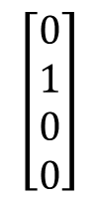
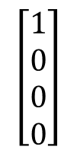
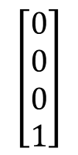
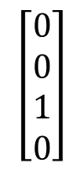
Encoding of Categorical Variables
Computers can process only numerical information
Question: How to represent categorical data in the form of numbers? – encoding
Ordinal variables can be given numerical labels based on their order
E.g. low – 1 , medium – 2 , high – 3
E.g. cold – 1 , warm – 2 , hot – 3
However, nominal variables can be encoded in above manner because the program might assume a non-existing order or importance
Therefore one hot encoding is used where nominal variables are represented as binary vectors
A colour variable which takes 4 different values can be one-hot encoded as:
Blue
Green
Yellow
Red
Blue
Green
Yellow
Red
$$\left[\begin{matrix}1 \\ 0 \\ 0 \\ 0\end{matrix}\right]$$
$$\left[\begin{matrix}0 \\ 1 \\ 0 \\ 0\end{matrix}\right]$$
$$\left[\begin{matrix}0 \\ 0 \\ 1 \\ 0\end{matrix}\right]$$
$$\left[\begin{matrix}0 \\ 0 \\ 0 \\ 1\end{matrix}\right]$$

Slide 14
Some Terminology
Input variables
Output/Target variables
Features
Data
Model
Parameters of the model
Training/Learning
Hyperparameters

Slide 15

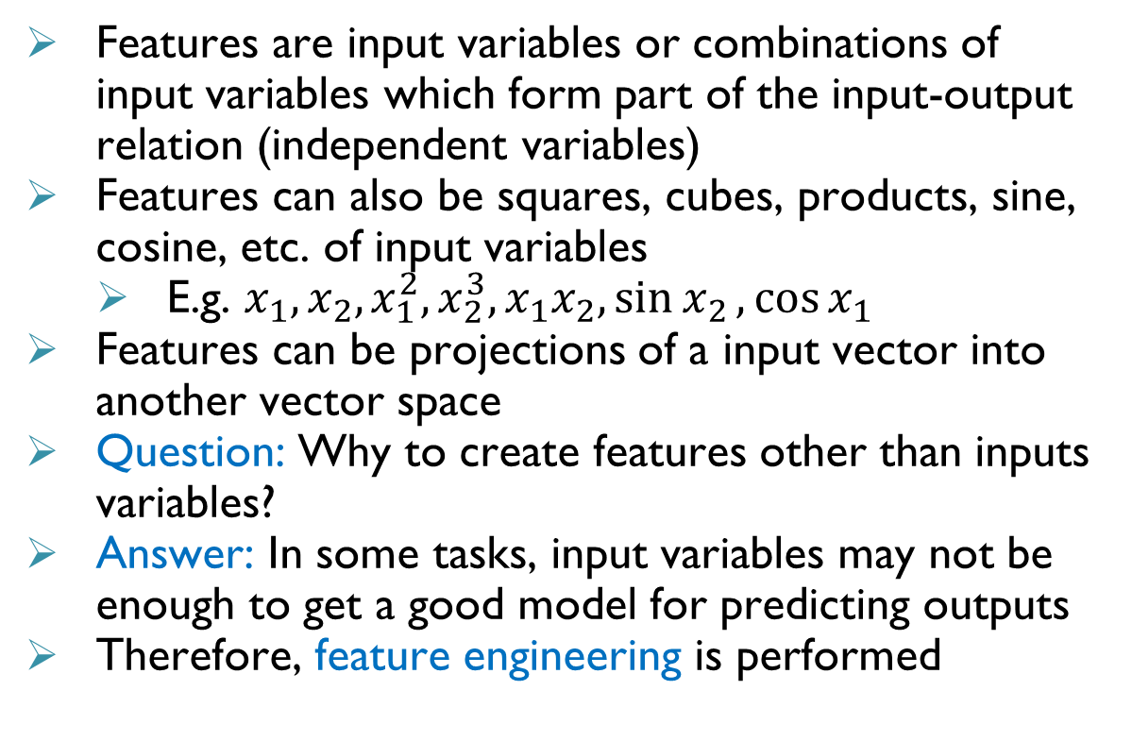
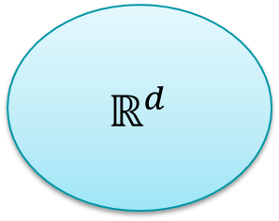
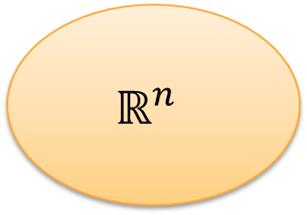
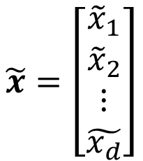
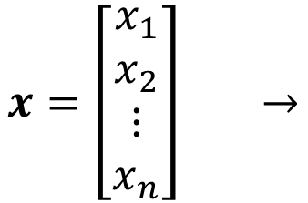

Features
Features are input variables or combinations of input variables which form part of the input-output relation (independent variables)
Features can also be squares, cubes, products, sine, cosine, etc. of input variables
E.g. $x_{1},x_{2}, x_{1}^{2}, x_{2}^{3},x_{1}x_{2},\sin{x_{2}},\cos{x_{1}}$
Features can be projections of a input vector into another vector space
Question: Why to create features other than inputs variables?
Answer: In some tasks, input variables may not be enough to get a good model for predicting outputs
Therefore, feature engineering is performed
$$x=\left[\begin{matrix}x_{1} \\ x_{2} \\ ⋮ \\ x_{n}\end{matrix}\right] →$$
$$\tilde{x}=\left[\begin{matrix}{\tilde{x}}_{1} \\ {\tilde{x}}_{2} \\ ⋮ \\ \tilde{x_{d}}\end{matrix}\right]$$
$$\tilde{x}$$
$$x$$
$$ℝ^{n}$$
$$ℝ^{d}$$

Slide 16
Feature Engineering
Selection, manipulation and transformation of raw inputs into features which improve the predictive power of the model
Feature engineering is important because a wrong feature can significantly impact the predictive ability of the model
Feature engineering may involve one or more of the following:
Feature selection based on exploratory analysis (independence and correlation) on available data
Feature creation based on domain knowledge
Feature transformation using techniques such as PCA
Feature engineering is one of most important pre-processing steps before a learning task

Slide 17
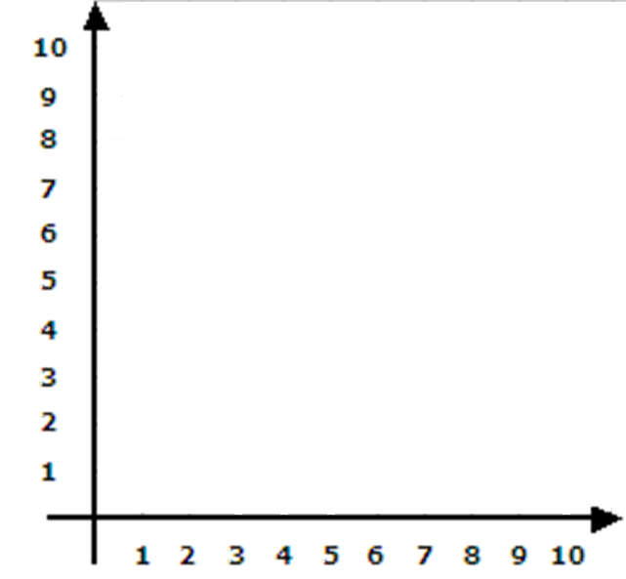
Feature Engineering: Exploratory Analysis
Exploratory analysis helps understand the relation between different variables (input and output)
Correlation: Indicates how the changes in one variable affect the other variable
Correlation coefficient measures correlation and lies between -1 and 1
Person’s coefficient: Captures linear relation and assumes constant variance between variables
Pearson Coefficient is close to 1

Slide 18
Feature Engineering: Exploratory Analysis
Pearson Coefficient is close to 0
Exploratory analysis helps understand the relation between different variables (input and output)
Correlation: Indicates how the changes in one variable affect the other variable
Correlation coefficient measures correlation and lies between -1 and 1
Person’s coefficient: Captures linear relation and assumes constant variance between variables

Slide 19
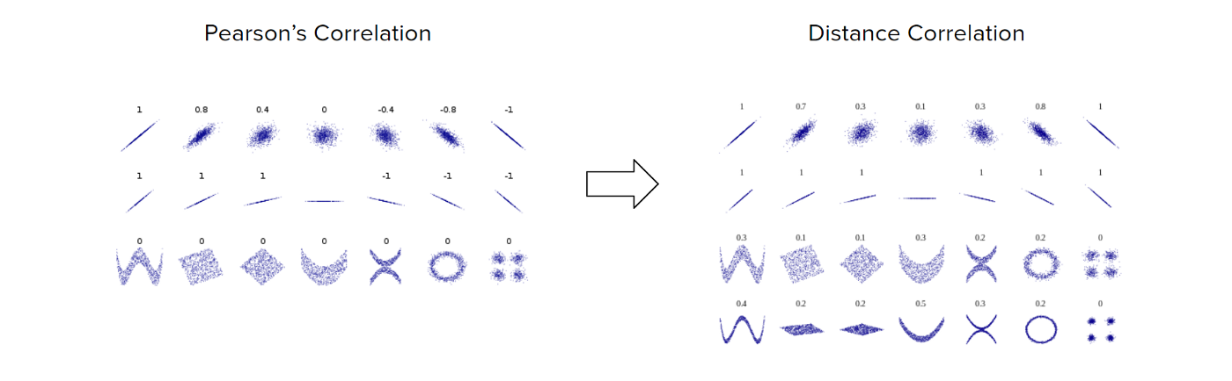
Feature Engineering: Exploratory Analysis
Exploratory analysis helps understand the relation between different variables (input and output)
Correlation: Indicates how the changes in one variable affect the other variable
Correlation coefficient measures correlation and lies between -1 and 1
Person’s coefficient: Captures linear relation and assumes constant variance between variables
Pearson Coefficient values
Image Source: Medium.com

Slide 20
Feature Engineering: Exploratory Analysis
Exploratory analysis helps understand the relation between different variables (input and output)
Correlation: Indicates how the changes in one variable affect the other variable
Correlation coefficient measures correlation and lies between -1 and 1
Person’s coefficient: Captures linear relation and assumes constant variance between variables
Spearman’s coefficient: Captures any monotonic relation between variables
Spearman Coefficient is close to 1

Slide 21
Feature Engineering: Exploratory Analysis
Exploratory analysis helps understand the relation between different variables (input and output)
Correlation: Indicates how the changes in one variable affect the other variable
Correlation coefficient measures correlation and lies between -1 and 1
Person’s coefficient: Captures linear relation and assumes constant variance between variables
Spearman’s coefficient: Captures any monotonic relation between variables
Distance correlation: Captures strength of association between non-linear variables (lies between 0 and 1)
Image Source: Medium.com

Slide 22
Some Terminology
Input variables
Output/Target variables
Features
Data
Model
Parameters of the model
Training/Learning
Hyperparameters

Slide 23
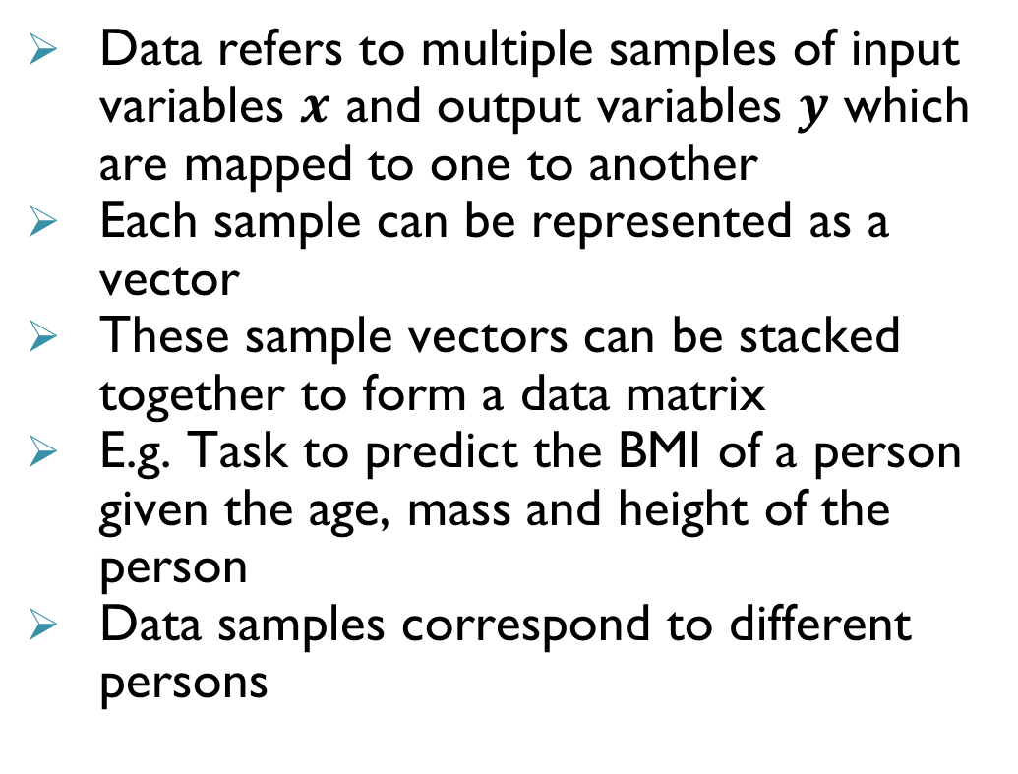

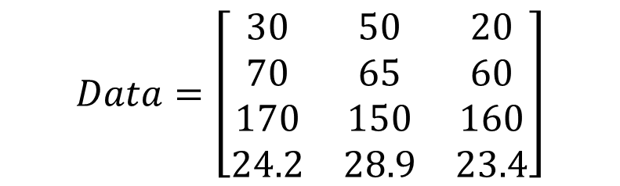
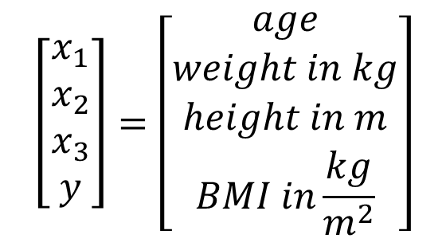
Data
Data refers to multiple samples of input variables $x$ and output variables $y$ which are mapped to one to another
Each sample can be represented as a vector
These sample vectors can be stacked together to form a data matrix
E.g. Task to predict the BMI of a person given the age, mass and height of the person
Data samples correspond to different persons
$$\left[\begin{matrix}x_{1} \\ x_{2} \\ x_{3} \\ y\end{matrix}\right]=\left[\begin{matrix}age \\ weight in kg \\ height in m \\ BMI in\frac{kg}{m^{2}}\end{matrix}\right]$$
$$\begin{matrix}\begin{aligned}Person \\ a\end{aligned} & \begin{aligned}Person \\ b\end{aligned} & \begin{aligned}Person \\ c\end{aligned}\end{matrix}$$
$$Data=\left[\begin{matrix}30 & 50 & 20 \\ 70 & 65 & 60 \\ 170 & 150 & 160 \\ 24.2 & 28.9 & 23.4\end{matrix}\right]$$

Slide 24
Data Pre-Processing
In practice, data is not always available in a form which can be used for machine learning tasks
Data pre-processing is to prepare the raw data for learning tasks
Following are some of the pre-processing steps:
Imputation: Refers to filling the missing values in the data set
Mean/median of all the known values of that variable can be used to impute numerical variables
Mode of all the known values can be used to impute categorical variables
New category called ‘missing’ can be introduced to impute categorical variables

Slide 25
Data Pre-Processing
In practice, data is not always available in a form which can be used for machine learning tasks
Data pre-processing is to prepare the raw data for learning tasks
Following are some of the pre-processing steps:
Imputation: Refers to filling the missing values in the data set
Handling outliers: Outliers are samples containing unusual or unexpected values which differ widely from the other samples and they can significantly affect the learning process
Removing samples with outliers if they are restricted to some variables
Alternately, outliers can be handled as missing value and imputation can be performed

Slide 26
Data Pre-Processing
In practice, data is not always available in a form which can be used for machine learning tasks
Data pre-processing is to prepare the raw data for learning tasks
Following are some of the pre-processing steps:
Imputation: Refers to filling the missing values in the data set
Handling outliers: Outliers are samples containing unusual or unexpected values which differ widely from the other samples and they can significantly affect the learning process
Encoding: Any categorical variables are to be encoded to ensure that all the input variables are numerical
Scaling: Refers to changing the range of the feature values to ensure that one feature does not dominate over the other when calculating distances (Euclidian distances)

Slide 27

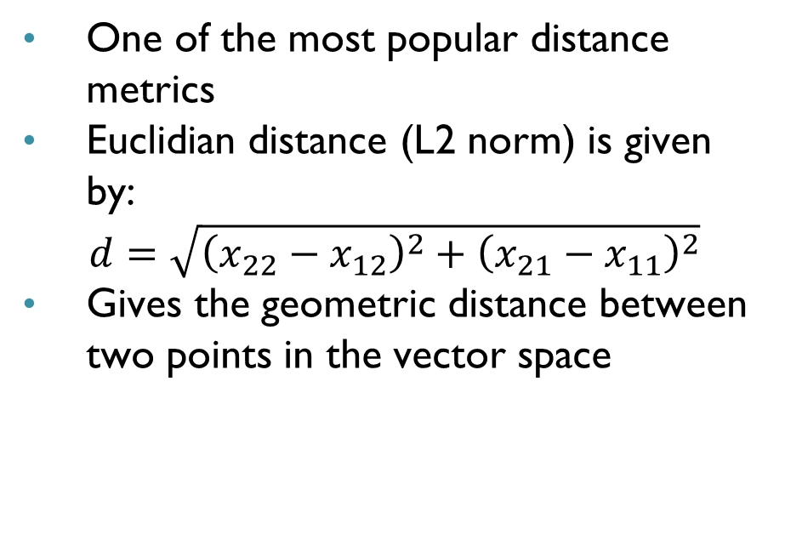




Euclidian Distance
$$x_{2}$$
One of the most popular distance metrics
Euclidian distance (L2 norm) is given by:
$$d=\sqrt{{\left(x_{22}−x_{12}\right)}^{2}+{\left(x_{21}−x_{11}\right)}^{2}}$$
Gives the geometric distance between two points in the vector space
$$\left[\begin{matrix}x_{21} \\ x_{22}\end{matrix}\right]$$
$$d$$
$$\left[\begin{matrix}x_{11} \\ x_{12}\end{matrix}\right]$$
$$x_{1}$$

Slide 28
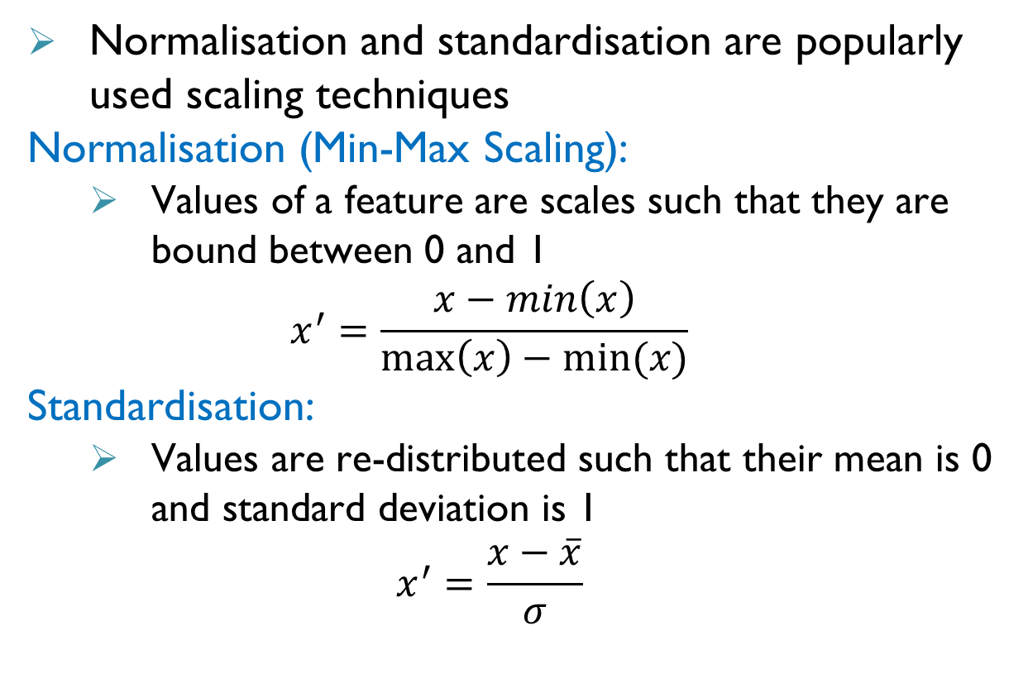



Data Pre-Processing: Scaling
Normalisation and standardisation are popularly used scaling techniques
Normalisation (Min-Max Scaling):
Values of a feature are scales such that they are bound between 0 and 1
$$x^{′}=\frac{x−min\left(x\right)}{\max\left(x\right)−min⁡(x)}$$
Standardisation:
Values are re-distributed such that their mean is 0 and standard deviation is 1
$$x^{′}=\frac{x−\overline{x}}{σ}$$
$$x_{1}=[\begin{matrix}5 & 8 & 10 & 15\end{matrix}]$$
Normalised vector
$$x′=[\begin{matrix}0 & 0.3 & 0.5 & 1\end{matrix}]$$
Standardised vector
$$x′=[\begin{matrix}−1.24 & −0.41 & 0.14 & 1.51\end{matrix}]$$

Slide 29
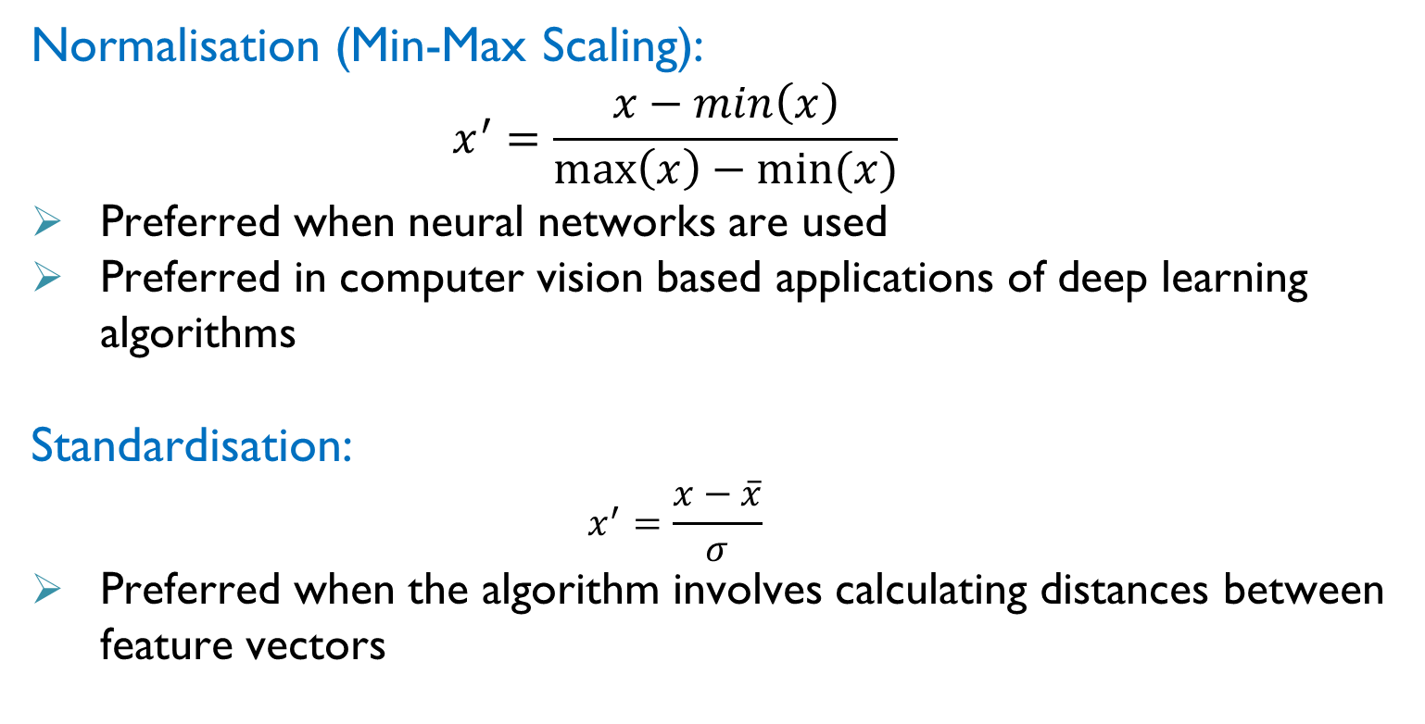
Data Pre-Processing: Scaling
Normalisation (Min-Max Scaling):
$$x^{′}=\frac{x−min\left(x\right)}{\max\left(x\right)−min⁡(x)}$$
Preferred when neural networks are used
Preferred in computer vision based applications of deep learning algorithms
Standardisation:
$$x^{′}=\frac{x−\overline{x}}{σ}$$
Preferred when the algorithm involves calculating distances between feature vectors

Slide 30
Some Terminology
Input variables
Output/Target variables
Features
Data
Model
Parameters of the model
Training/Learning
Hyperparameters

Slide 31
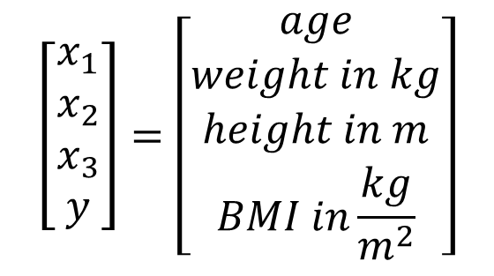
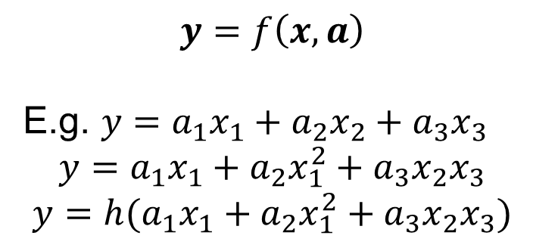
Model and its Parameters
Model refers to the function or relation between the inputs and outputs for the given task
Model Parameters: Variables that are internal to the model and uniquely identify it
Not set manually and vary based on chosen model and data
Learnt or estimated from data
Required for making predictions and stored as a part of the model
$$\left[\begin{matrix}x_{1} \\ x_{2} \\ x_{3} \\ y\end{matrix}\right]=\left[\begin{matrix}age \\ weight in kg \\ height in m \\ BMI in\frac{kg}{m^{2}}\end{matrix}\right]$$
$$y=f\left(x,a\right)$$
E.g. $y=a_{1}x_{1}+a_{2}x_{2}+a_{3}x_{3}$
$$y=a_{1}x_{1}+a_{2}x_{1}^{2}+a_{3}x_{2}x_{3}$$
$$y=h(a_{1}x_{1}+a_{2}x_{1}^{2}+a_{3}x_{2}x_{3})$$

Slide 32
Some Terminology
Input variables
Output/Target variables
Features
Data
Model
Parameters of the model
Training/Learning
Hyperparameters

Slide 33
Learning/Training and Hyperparameters
Learning/Training a model refers to estimating the parameters that give a relation for predicting the output variables given the input features
Hyperparameters are variables which are external to the model but are required to train the model
Cannot be estimated from data
Need to be specified by the user
Best value for a hyperparameter is not known
Generally decided based on experience, heuristics or trial and error
Need to be tuned to get a good model

Slide 34
Supervised Learning Tasks

Slide 35
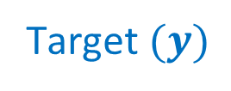
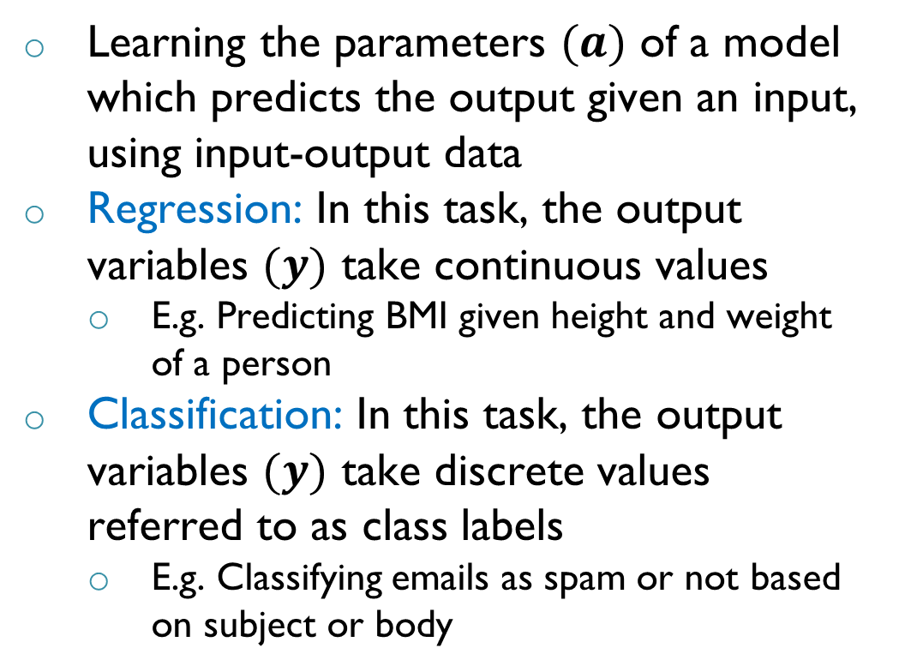
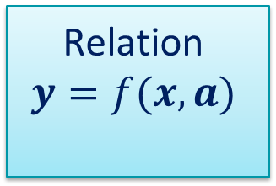
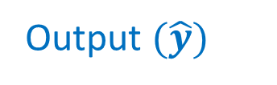
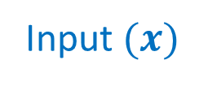
Supervised Learning Tasks
Learning the parameters $(a)$ of a model which predicts the output given an input, using input-output data
Regression: In this task, the output variables $(y)$ take continuous values
E.g. Predicting BMI given height and weight of a person
Classification: In this task, the output variables $(y)$ take discrete values referred to as class labels
E.g. Classifying emails as spam or not based on subject or body
Supervised Learning Task
Relation
$$y=f(x,a)$$
Input $(x)$
Output $(\hat{y})$
$$−$$
Feedback
Target $(y)$

Slide 36
Regression and its Types

Slide 37
Regression
Regression problems
Nature of relationship
Linear
Non-linear
Number of dependent and independent variables
Univariate
One dependent and One independent
Multivariate
Multiple dependent and Multiple independent

Slide 38
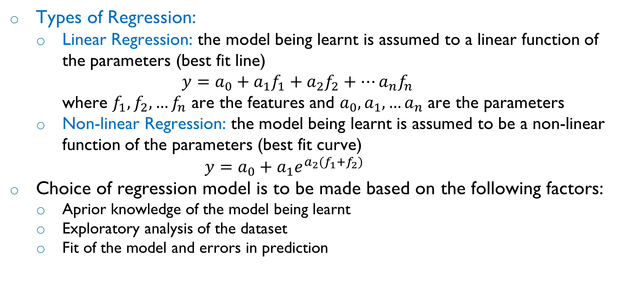
Regression
Types of Regression:
Linear Regression: the model being learnt is assumed to a linear function of the parameters (best fit line)
$$y=a_{0}+a_{1}f_{1}+a_{2}f_{2}+…a_{n}f_{n}$$
where $f_{1},f_{2},…f_{n}$ are the features and $a_{0},a_{1},…a_{n}$ are the parameters
Non-linear Regression: the model being learnt is assumed to be a non-linear function of the parameters (best fit curve)
$$y=a_{0}+a_{1}e^{a_{2}(f_{1}+f_{2})}$$
Choice of regression model is to be made based on the following factors:
Aprior knowledge of the model being learnt
Exploratory analysis of the dataset
Fit of the model and errors in prediction

Slide 39






Choice of Regression Model
$$y$$
$$y$$
$$y=a_{0}+a_{1}x$$
$$y=f(x,a)$$
$$x$$
$$x$$

Slide 40
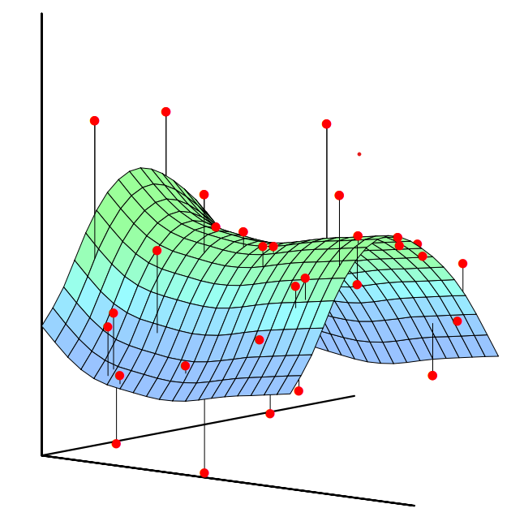
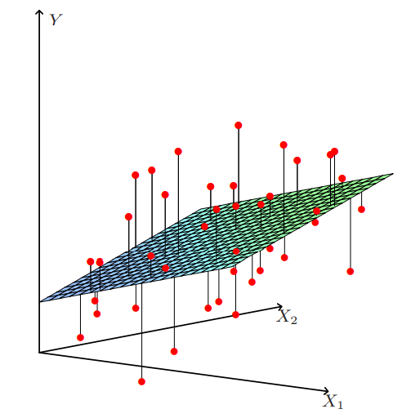
Linear and Non-Linear Regression

Slide 41
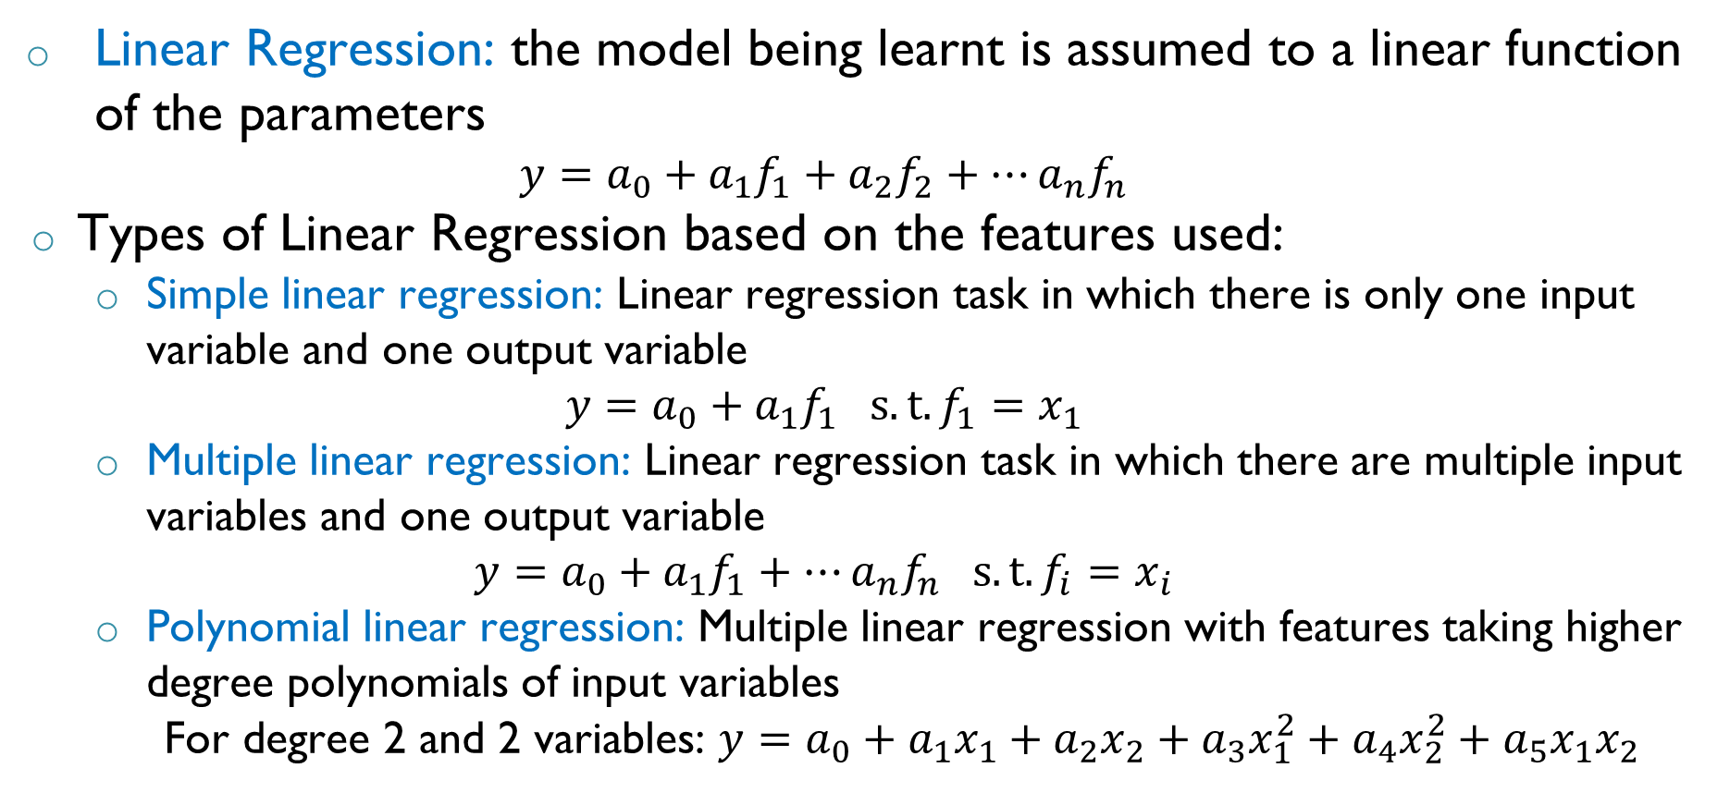
Linear Regression
Linear Regression: the model being learnt is assumed to a linear function of the parameters
$$y=a_{0}+a_{1}f_{1}+a_{2}f_{2}+…a_{n}f_{n}$$
Types of Linear Regression based on the features used:
Simple linear regression: Linear regression task in which there is only one input variable and one output variable
$$y=a_{0}+a_{1}f_{1} s.t. f_{1}=x_{1}$$
Multiple linear regression: Linear regression task in which there are multiple input variables and one output variable
$$y=a_{0}+a_{1}f_{1}+…a_{n}f_{n} s.t. f_{i}=x_{i}$$
Polynomial linear regression: Multiple linear regression with features taking higher degree polynomials of input variables
For degree 2 and 2 variables: $y=a_{0}+a_{1}x_{1}+a_{2}x_{2}+a_{3}x_{1}^{2}+a_{4}x_{2}^{2}+a_{5}x_{1}x_{2}$

Slide 42
Training a Linear Regression Model

Slide 43




Residuals or Errors
$$y$$
In general, a regression model (line) does not exactly fit all the data
Therefore, there is a difference in the predicted output and actual output
Residual: Vertical distance between the data point and the regression line
Also referred to as error in prediction
$$ε_{i}=\left(y_{i}−{\hat{y}}_{i}\right)=(y_{i}−\left(a_{0}+a_{1}x_{i}\right))$$
Question: How are the residuals useful?
For a good regression model, the residuals should be as low as possible
$$y=a_{0}+a_{1}x$$
$$x$$

Slide 44

Solution to Regression Problem
$$y$$
Objective: Estimate the parameters of the model such that the sum of squared errors (SSE) (loss function) is minimised
For simple linear regression:
$$SSE=\sum_{i}{ε_{i}^{2}}=\sum_{i}{{\left(y_{i}−\left(a_{0}+a_{1}x_{i}\right)\right)}^{2}}$$
To minimise SSE:
$$a_{1}=\frac{\sum_{i}{\left(x_{i}−\overline{x}\right)\left(y_{i}−\overline{y}\right)}}{\sum_{i}{{\left(x_{i}−\overline{x}\right)}^{2}}}$$
$$a_{0}=\left(\overline{y}−a_{1}\overline{x}\right)$$
$$y=a_{0}+a_{1}x$$
$$x$$

Slide 45
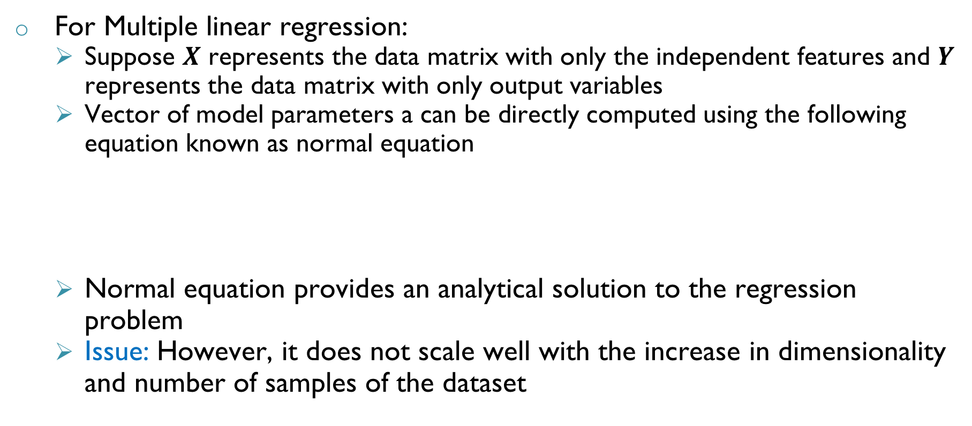
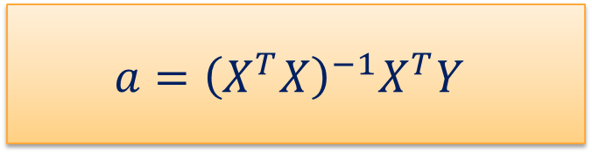
Solution to Regression Problem
For Multiple linear regression:
Suppose $X$ represents the data matrix with only the independent features and $Y$ represents the data matrix with only output variables
Vector of model parameters a can be directly computed using the following equation known as normal equation
Normal equation provides an analytical solution to the regression problem
Issue: However, it does not scale well with the increase in dimensionality and number of samples of the dataset
$$a={\left(X^{T}X\right)}^{−1}X^{T}Y$$

Slide 46
Solution to Regression Problem
Alternative - Numerical Approach:
To initialize the parameters of the model randomly
To update the parameters of the model in a iterative manner such that the loss function (SSE) decreases at each iteration
Note: For different parameters, the models are different resulting in different SSE
Repeat the updates until the loss function is minimised
Question: How to update the parameters such that loss function deceases at each step? – Gradient Descent

Slide 47
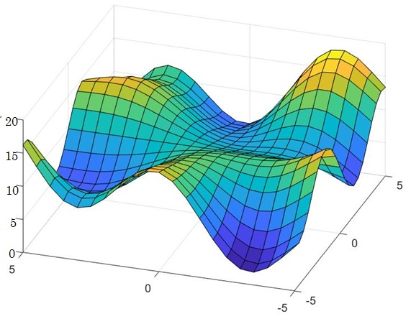

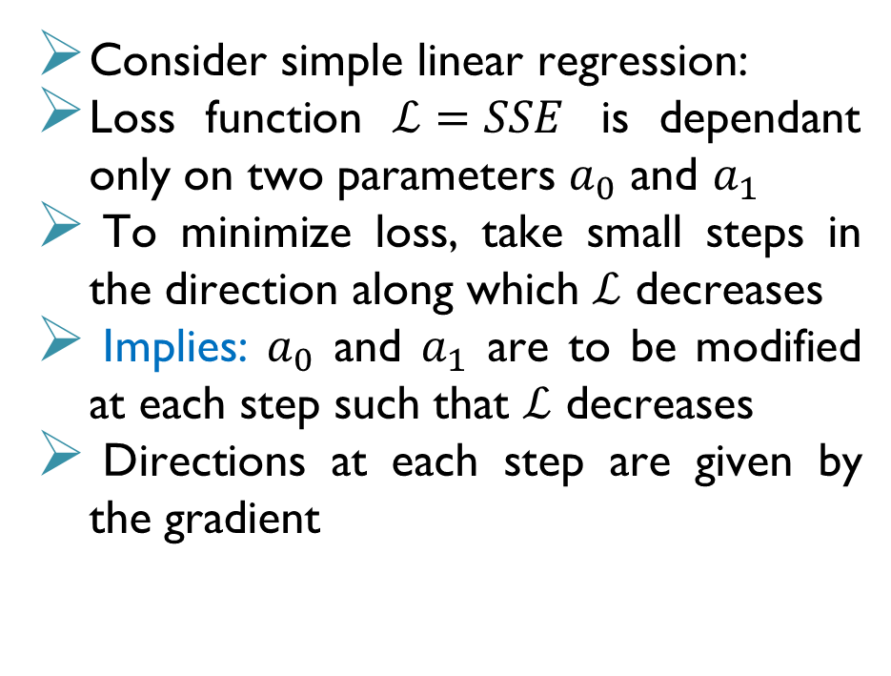




Gradient Descent: Intuition
Consider simple linear regression:
Loss function $ℒ=SSE$ is dependant only on two parameters $a_{0}$ and $a_{1}$
To minimize loss, take small steps in the direction along which $ℒ$ decreases
Implies: $a_{0}$ and $a_{1}$ are to be modified at each step such that $ℒ$ decreases
Directions at each step are given by the gradient
$$ℒ$$
$$\left[\begin{matrix}a_{0}^{1} \\ a_{1}^{1} \\ ℒ^{1}\end{matrix}\right]$$
$$a_{1}$$
$$\left[\begin{matrix}a_{0}^{2} \\ a_{1}^{2} \\ ℒ^{2}\end{matrix}\right]$$
$$a_{0}$$

Slide 48
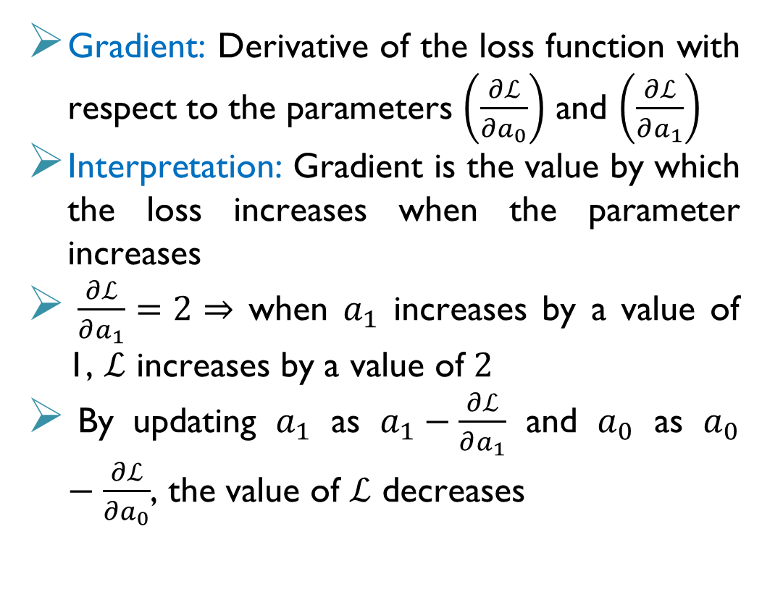
Gradient Descent
Gradient: Derivative of the loss function with respect to the parameters $\left(\frac{∂ℒ}{∂a_{0}}\right)$ and $\left(\frac{∂ℒ}{∂a_{1}}\right)$
Interpretation: Gradient is the value by which the loss increases when the parameter increases
$\frac{∂ℒ}{∂a_{1}}=2⇒$ when $a_{1}$ increases by a value of 1, $ℒ$ increases by a value of $2$
By updating $a_{1}$ as $a_{1}−\frac{∂ℒ}{∂a_{1}}$ and $a_{0}$ as $a_{0}−\frac{∂ℒ}{∂a_{0}}$, the value of $ℒ$ decreases
$$ℒ$$
$$\left[\begin{matrix}a_{0}^{1} \\ a_{1}^{1} \\ ℒ^{1}\end{matrix}\right]$$
$$a_{1}$$
$$\left[\begin{matrix}a_{0}^{2} \\ a_{1}^{2} \\ ℒ^{2}\end{matrix}\right]$$
$$a_{0}$$

Slide 49
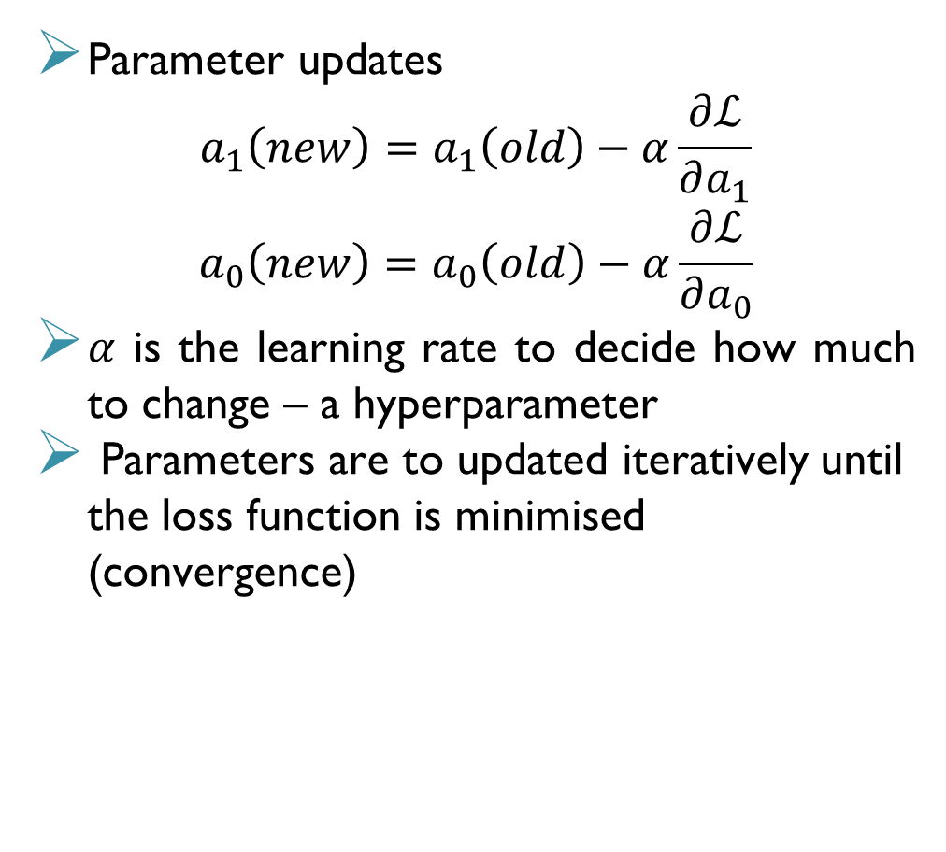
Gradient Descent
Parameter updates
$$a_{1}\left(new\right)=a_{1}\left(old\right)−α\frac{∂ℒ}{∂a_{1}}$$
$$a_{0}\left(new\right)=a_{0}\left(old\right)−α\frac{∂ℒ}{∂a_{0}}$$
$α$ is the learning rate to decide how much to change – a hyperparameter
Parameters are to updated iteratively until the loss function is minimised (convergence)
$$ℒ$$
$$\left[\begin{matrix}a_{0}^{1} \\ a_{1}^{1} \\ ℒ^{1}\end{matrix}\right]$$
$$a_{1}$$
$$\left[\begin{matrix}a_{0}^{2} \\ a_{1}^{2} \\ ℒ^{2}\end{matrix}\right]$$
$$a_{0}$$

Slide 50
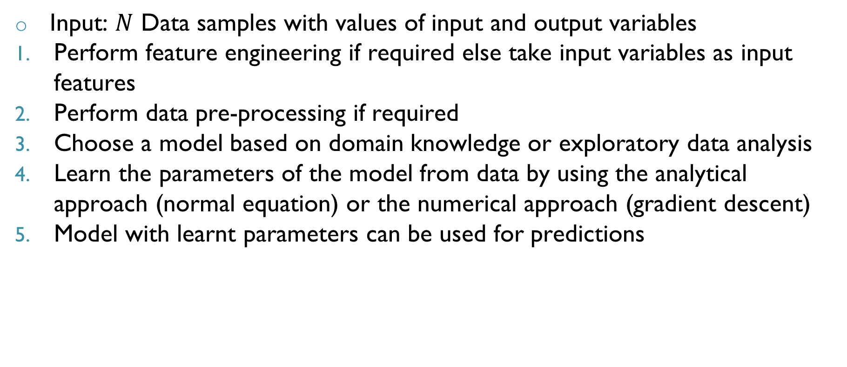
Summary: Steps to Regression
Input: $N$ Data samples with values of input and output variables
Perform feature engineering if required else take input variables as input features
Perform data pre-processing if required
Choose a model based on domain knowledge or exploratory data analysis
Learn the parameters of the model from data by using the analytical approach (normal equation) or the numerical approach (gradient descent)
Model with learnt parameters can be used for predictions

Slide 51
Model Validation

Slide 52
Model Validation
Objective of Regression: To obtain a good model which predicts well on unseen data
Model obtained after training is only known to perform well on seen data
Therefore, model validation is performed to evaluate a trained model in an unbiased manner
If the model performance during is not acceptable, either a different model is to be chosen or the hyperparameters need to be tuned
To perform model validation, the given dataset is split into two subsets:
Training set: Set of samples used to train the or learn the model parameters. So loss function is minimised over this dataset
Validation set: Set of samples used to provide an unbiased evaluation of the model

Slide 53
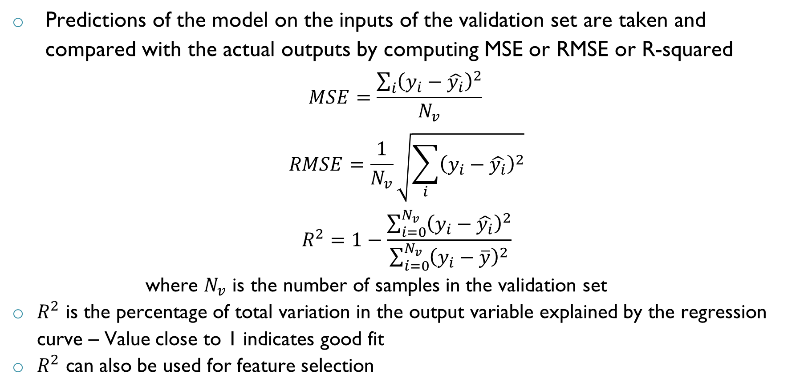
Model Validation
Predictions of the model on the inputs of the validation set are taken and compared with the actual outputs by computing MSE or RMSE or R-squared
$$MSE=\frac{\sum_{i}{{\left(y_{i}−\hat{y_{i}}\right)}^{2}}}{N_{v}}$$
$$RMSE=\frac{1}{N_{v}}\sqrt{\sum_{i}{{\left(y_{i}−\hat{y_{i}}\right)}^{2}}}$$
$$R^{2}=1−\frac{\sum_{i=0}^{N_{v}}{{\left(y_{i}−\hat{y_{i}}\right)}^{2}}}{\sum_{i=0}^{N_{v}}{{\left(y_{i}−\overline{y}\right)}^{2}}}$$
where $N_{v}$ is the number of samples in the validation set
$R^{2}$ is the percentage of total variation in the output variable explained by the regression curve – Value close to 1 indicates good fit
$R^{2}$ can also be used for feature selection

Slide 54
Model Validation Techniques
Different model validation techniques exist which can be used to chosen a good model:
Hold out
K-fold cross validation
Leave-one-out cross validation
All validation techniques involve splitting the given data into training and validation sets and validating using one of the metrics

Slide 55
Model Validation: Hold out
Given Data – N Samples
Validation
data
Training data
Most basic validation method where given data is split into training and validation sets in the ratio of 80:20 or 70:30
Issue: Randomly splitting the data may result in sampling bias
The distribution of training and validation data sets may not represent the same population distribution from the original data is drawn

Slide 56
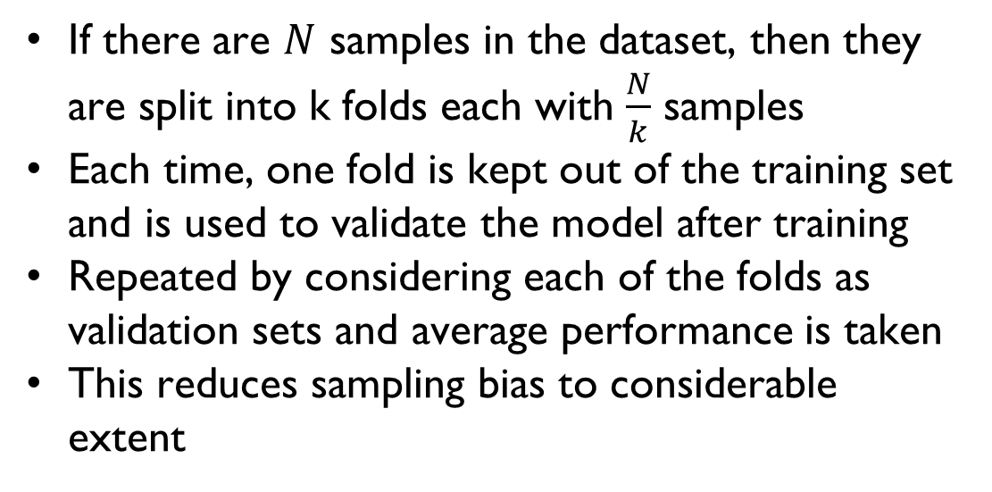
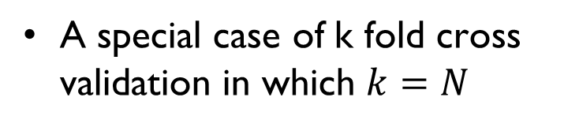
Model Validation: K-fold and Leave-one-out
Given Data – N samples
Given Data – N Samples
Fold 1
Fold 2
Fold k
Fold 1
Fold 2
Fold N
A special case of k fold cross validation in which $k=N$
If there are $N$ samples in the dataset, then they are split into k folds each with $\frac{N}{k}$ samples
Each time, one fold is kept out of the training set and is used to validate the model after training
Repeated by considering each of the folds as validation sets and average performance is taken
This reduces sampling bias to considerable extent

Slide 57
Steps in Training a Regression model
Collect/Extract data
Pre-Process the data
Perform feature engineering
Split Data into Training and Validation sets
Choose the type of regression model
Build the Model
Perform model validation
Choose the best model for predictions

Slide 58
Summary
Machine learning enables computers to learn to perform different kinds of tasks
Supervised learning, unsupervised learning and reinforcement learning are different branches of ML
Supervised learning involves learning an input-output relation from mapped data for predictive purposes
Regression task is when output is a continuous variable while it is classification when output is a discrete variable
Regression is a function which gives the output variables given a set of input features
Parameters of a regression model can be obtained analytically (normal equation) or numerically (gradient descent)
Regression models needs to be validated to ensure that it predicts well on unseen data

Slide 59

THANK YOU

